Slide 1
Safety Management System (SMS)
2017 PPTA Winter Meeting
Ream Lazaro, FTA Contractor

Slide 2
Agenda
FTA Bus Safety Program Overview
Defining SMS and its Benefits
Organizational Accident
Practical Drift
Employee Safety Reporting
SMS Framework
SMS Roles and Responsibilities
SMS Lessons Learned
Key SMS Resources
Q&A

Slide 3
Bus safety program overview

Slide 4
FTA Bus Safety Program
Voluntary Onsite Reviews
Orientation Seminars
Industry Coordination and Outreach
Voluntary onsite reviews
Orientation seminars
Ongoing outreach
Notes:
Program delivery
State DOT Seminars (we’ve conducted 50 to date)
Resource website (with over 1,000 practical resources like checklists, templates, procedures, and sample plans)
Voluntary onsite reviews (we’ve conducted nearly 75 to date)
And while we continue to focus on safety and have shifted the scope of the reviews to include SMS, security and emergency preparedness remain as critical components of each review.
What happens during onsite reviews?
Agency safety, security, emergency preparedness activities reviewed using assessment questionnaire as catalyst for discussion
Interviews conducted with key staff, pertinent documents reviewed, facilities/equipment inspected
This is not an audit
Atmosphere is one of assistance and guidance
Effective practices noted to share nationally with other transit agencies
Feedback and technical assistance delivered throughout the review, in an exit interview, and in a Final Report
How to get involved?
Transit systems volunteer for a review
FTA team coordinates with all review stakeholders regarding schedule
Volunteer Transit Agency
State DOT
FTA Regional Office
Notification package sent to volunteer agency
All review stakeholders are copied on correspondence
Volunteer transit agencies encouraged to contact the review team with any questions
State DOT and FTA Regional Offices invited to attend
What happens during the State DOT orientation seminars?
The State DOT co-hosts the event and 1 rep from each 5311 sub-recipient bus agency in the state is invited to attend
Assistance provided to the State DOT and bus transit systems in attendance includes:
Identifying the elements of Transit Bus Safety and Security Excellence
Identifying best practices in safety and security
Identifying gaps and needs in their safety and security program
Utilizing the website to locate and download information that will fill identified safety and security program gaps
Creating a plan to achieve agency safety, security, and emergency preparedness excellence
Explanation of background and overview of the Bus Program
Ongoing outreach
FTA supports its partners (APTA, State DOTS, transit associations) in delivering presentations at venues, such as this, to provide program updates and information
FTA responds to technical assistance questions posed by the industry and its partners.

Slide 5
Defining sms & its benefits

Slide 6
Managing or Reacting
When we talk about managing safety, are we really “managing” or are we simply “reacting?”
Transit industry has tended towards being reactive as opposed to proactive
Typically, it wasn’t until an accident or incident occurred that we focused on the safety issue and how to resolve it

Slide 7
What is SMS?
Formal, top-down, organization-wide, data-driven approach to managing safety risk and assuring effectiveness of safety risk mitigations.
Includes systematic policies, procedures, and practices for managing safety risk.

Slide 8
SMS in General
A management system
Systematic
Safety management is a core agency function
(e.g., financial management, HR management, IT management)
Provides decision-making tools for management

Slide 9
What SMS does
Ensures timely information about safety risks
Enables executives to make informed decisions about prioritized allocation of safety resources
Actively seeks to identify hazards and mitigate their potential consequences
Fosters system-wide communication about safety issues up, down and across the agency
Improves safety culture by involving front-line employees in hazard identification

Slide 10
Five Questions SMS Answers
What are our most serious safety concerns?
How do we know this?
What are we doing about them?
Is what we are doing working?
How do we know what we are doing is working?

Slide 11
The Organizational Accident

Slide 12
Two Realities of Accident Causation
Accidents are result of individual failures
Actions/inactions of people
Accidents are result of organization failures
Actions/inactions of organizations

Slide 13
Organizational Accidents
“Organizational accidents have multiple causes involving many people operating at different levels of their respective companies.”
Professor James Reason, “Managing the Risks of Organizational Accidents

Slide 14
Swiss Cheese Model
Organization
Workplace
People
Defenses
Safety
Breakdown
Hazards
Some holes due to
latent conditions
Some holes due to
active failures

Slide 15
Human Error
Individuals do not cause organizational accidents
Individuals trigger conditions leading to organizational accidents
Organizational accidents have deeper and broader roots

Slide 16
“The discovery of human error should be considered the starting point of the investigation, not the ending point.”
- ISASI Forum

Slide 17
Practical Drift

Slide 18
Practical Drift Defined
A drift from the performance of work as imagined to performance of work as it is actually carried out

Slide 19
Imperfect Systems – The Practical Drift
“Work as imagined”
System and Tasks as designed and engineered
Procedure
Start of Operations
“Uncoupling of practice from procedure”
Over Time
Why? What happened?
Service delivery pressures
Procedure no longer practical
Short cuts are more efficient
Supervisor allows it
Informal processes
Training inadequately conveyed risk
Local Reality
Practical Drift
“Work as actually done”
Practice

Slide 20
Navigating the Drift – The Need for Data
Baseline Performance
Practical Drift
Organization
The difference between “where we are” and “where we thought we were”
Operational Performance

Slide 21
Employee Safety Reporting

Slide 22
Characteristics of Effective Employee Safety Reporting
Employees actually use the system; voluntary reporting increases
Employees feel their concerns are being heard and addressed
Managers have better understanding of how safe their agency’s operations really are
Encourages dialogue and transparency about safety
Leads to timely safety improvements
Supports development of learning culture versus punitive culture
Notes:
Compared to other sources of information that feed into Safety Risk Management and Safety Assurance

Slide 23
How does a transit agency increase voluntary employee safety reporting?
Challenge – Employees will not voluntarily share information if they feel it could lead to a negative outcome
Solution – Reduce incentives not to report and increase incentives to report

Slide 24
How does a transit agency increase voluntary employee safety reporting?
Why don’t employees report?
Not that important
Change Incentives to Report
Demonstrate that reporting is valued
Clarify what’s important
Empower employees

Slide 25
How does a transit agency increase voluntary employee safety reporting?
Why don’t employees report?
Not that important
Affects team’s safety record
Change Incentives to Report
Prioritize an accurate safety risk picture
Emphasize benefits for safety, not safety record

Slide 26
How does a transit agency increase voluntary employee safety reporting?
Why don’t employees report?
Not that important
Affects team’s safety record
Nothing would be done to fix it
Change Incentives to Report
Evaluate each report
Follow up and show what was done as a result of reporting

Slide 27
How does a transit agency increase voluntary employee safety reporting?
Why don’t employees report?
Not that important
Affects team’s safety record
Nothing would be done to fix it
Blame for incident
Treated or disciplined unfairly
Change Incentives to Report
Balance learning and accountability
Be consistent – set & follow clear guidelines for unacceptable behavior

Slide 28
How does a transit agency increase voluntary employee safety reporting?
Human Error | At-Risk Behavior | Reckless Behavior
An inadvertent action – slip, lapse, mistake | A choice – risk not recognized or believed justified | Conscious disregard of unreasonable risk
Manage through: Processes & procedures Checklists Training Design | Manage through: Increase situational awareness Remove incentives for at-risk behavior Create incentives for safe behavior | Manage through: Remedial action Punitive action

Slide 29
Sms framework

Slide 30
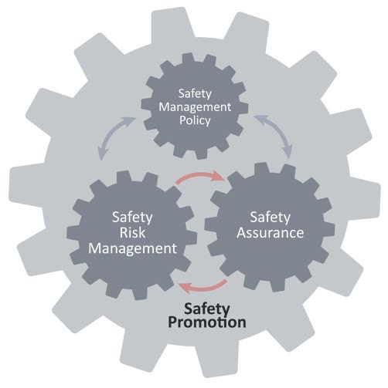

Slide 31
Safety Management Policy

Slide 32
Safety Management Policy Sub-Components
Safety Management
Policy
Safety Management Policy Statement
Safety Accountabilities & Responsibilities
Integration with Public Safety & Emergency Management
SMS Documentation & Records

Slide 33
Safety Risk Management

Slide 34
Safety Risk Management Sub-Components
Safety Risk
Management
Hazard Identification & Analysis
Safety Risk Evaluation & Mitigation

Slide 35
Safety Assurance

Slide 36
Safety Assurance Sub-Components
Safety Assurance
Safety performance monitoring & measurement
Management
of
change
Continuous improvement

Slide 37
Safety Promotion

Slide 38
Safety Promotion Sub-Components
Safety Promotion
Safety Communication
Competencies and Training

Slide 39
SMS Roles and Responsibilities

Slide 40
Who is the Accountable Executive
Should be transit agency’s chief executive
At some transit agencies, roles and responsibilities may be fluid based on structure and reporting relationships
Must be one primary decision-maker that is ultimately responsible for safety management
It is a basic management tenet that accountabilities flow top-down

Slide 41
Accountable Executive Responsibilities
Ensure safety concerns are considered in on-going budget planning process
Ensure transparency in safety priorities for oversight entity and employees
Establish guidance on level of acceptable safety risk
Ensure Safety Management Policy Statement is appropriate and communicated throughout agency

Slide 42
Appoint the SMS Lead
Must have explicit support from the Accountable Executive
Must have formal access [as per governance structure] to Accountable Executive
Should be formally appointed and trained
For smaller agencies, may be current safety manager
For larger agencies, may be head of Safety Dept. or senior member of Safety Dept.
Notes:
Effective SMS implementation depends on the expertise and skills of the individual that is responsible for leading the implementation effort. However, it is also extremely important that this Lead have ongoing support from and access to the accountable executive to present high priority safety matters and ensure resources are available to achieve SMS outcomes.
The appointment of the SMS lead must be formal and communicated throughout the agency. It goes without saying that the SMS Lead must be appropriately trained to carry out the day-to-day operation of the SMS.
In smaller transit agencies, the SMS lead may be the individual that has responsibility for safety, even though that my not be their only job responsibility. In larger transit agencies, the SMS lead may be recruited from senior safety department staff and this person’s sole responsibility could be leading the SMS.

Slide 43
SMS Manager/Key Safety Personnel Responsibilities
Manages SMS implementation plan on behalf of Accountable Executive
Directs hazard identification and safety risk evaluation
Monitors mitigation activities
Provides periodic reports on safety performance
Maintains safety documentation
Plans and organizes safety training
Scale of this function varies depending on size of organization

Slide 44
Build the SMS Implementation Team
Must have clearly defined roles and responsibilities
Must be interdisciplinary
Operations and Maintenance departments/functions must be represented
Must have clear tasks to be executed over a specific time period
Supports the SMS Lead
Will vary based on agency size, complexity, and operating characteristics
Notes:
To assist the SMS Lead, it is critical that the SMS implementation team consists of subject matter experts from all relevant operational, maintenance and safety-related functions to effectively develop and implement needed activities, processes, and tools. A fully represented implementation team also ensures that communication structures are established that reinforce the a transit agency’s ability to effectively implement its SMS.
Again, agency size, complexity and operating characteristics will determine the number of members on the team. In a larger transit agency, the initial SMS implementation activities will consume a significant amount of team member time. However, once the implementation is under way, that time commitment will be significantly reduced. As expected, in a small transit agency the initial implementation activities and time required to carry them out will be significantly less than that of a large transit agency.
Just as with the Accountable Executive and the SMS Lead, the SMS roles and responsibilities of the team will need to be defined and documented and the members will have to have a clear understanding of these, as well as an understanding of their relationship with the SMS lead.

Slide 45
Sms lessons learned

Slide 46
Key Message for Top Executives
Commitment to SMS is vital for its success
Top Executive must endorse it, resource it and ensure it is used
Communicate often with your employees
Emphasize your safety priorities
Employees more likely to report and discuss safety concerns if it is easy
Integrate SMS into management of all service delivery operations
Improves agency’s ability to address safety concerns across the organization

Slide 47
Engage and Empower Key Players
Identify the SMS Lead
Form multi-functional team to draft SMS Implementation Plan
Schedule meetings and training for SMS team members
Ensure SMS team has access to all required information
Emphasize that SMS is everyone’s responsibility

Slide 48
Begin with the End in Mind
Define SMS objectives and expectations
Help create an organizational vision of what SMS success will look like
SMS needs to align with your agency’s primary purpose: service delivery
Build on the practices you have in place

Slide 49
Make Communication Front and Center
Ensure people understand their SMS roles and responsibilities
Ensure Executive Leadership receives routine SMS updates
Provide regular SMS updates to oversight authority and union leadership (as applicable)

Slide 50
Use and Improve the SMS
SMS implementation will not happen all at once
SMS needs time for implementation and to mature
Components of SMS will move from development to operations as they are put into place
SMS will always be a work in progress

Slide 51
Key resources

Slide 52
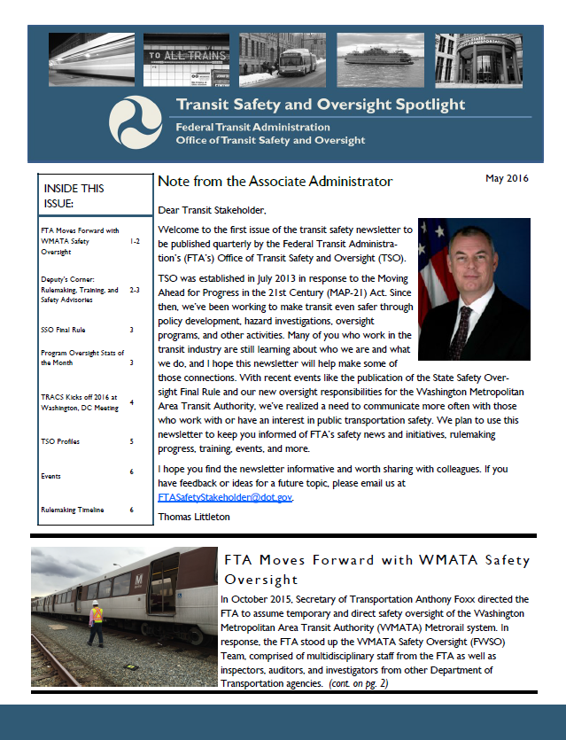
Key Resources
Read, watch, and participate
Get trained
Sign up to receive updates
Review FTA’s SMS Framework at http://transit.dot.gov
Participate in webinars explaining new regulations and guidance
Visit FTA’s YouTube page to view previous webinars
Read our newsletter TSO Spotlight
Through FTA’s safety website:
Take the SMS Awareness online course
Sign up for classroom courses
Request an Individual Training Profile (ITP)
Courses based on your role
FTA announcements and new documents
https://public.govdelivery.com/accounts/USDOTFTA/subscriber/new
Questions? Comments? Email us at FTASafetyStakeholder@dot.gov

Slide 53
Q & A
Notes:
Thank you very much for your ongoing commitment to transit safety.
Are there any questions?

